Slide 1
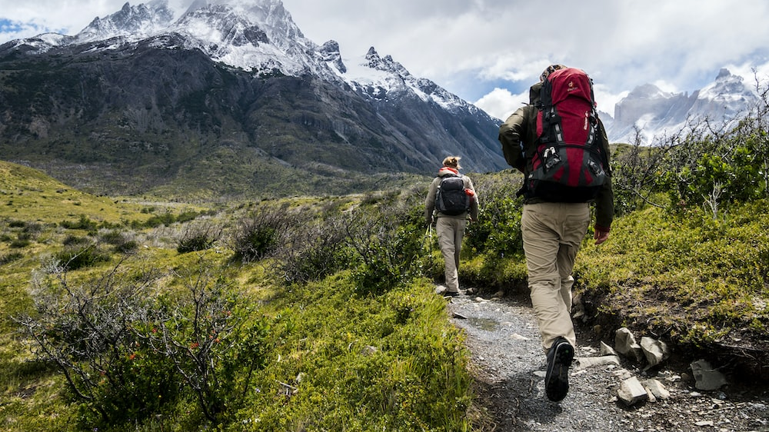
Outland Adventures
Case Study

Slide 2
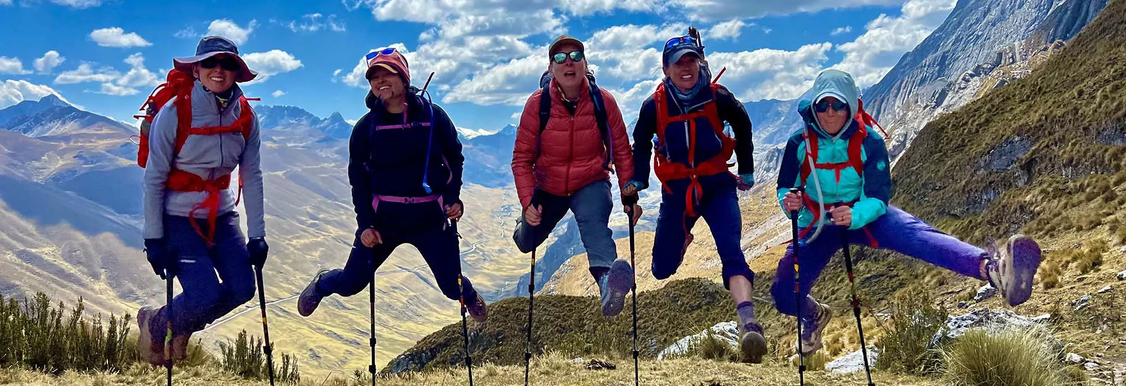
Juan Taylor Michelle Choe Chris Kaiser Estiven Hernandez Julia Gonzalez
Team Members

Slide 3

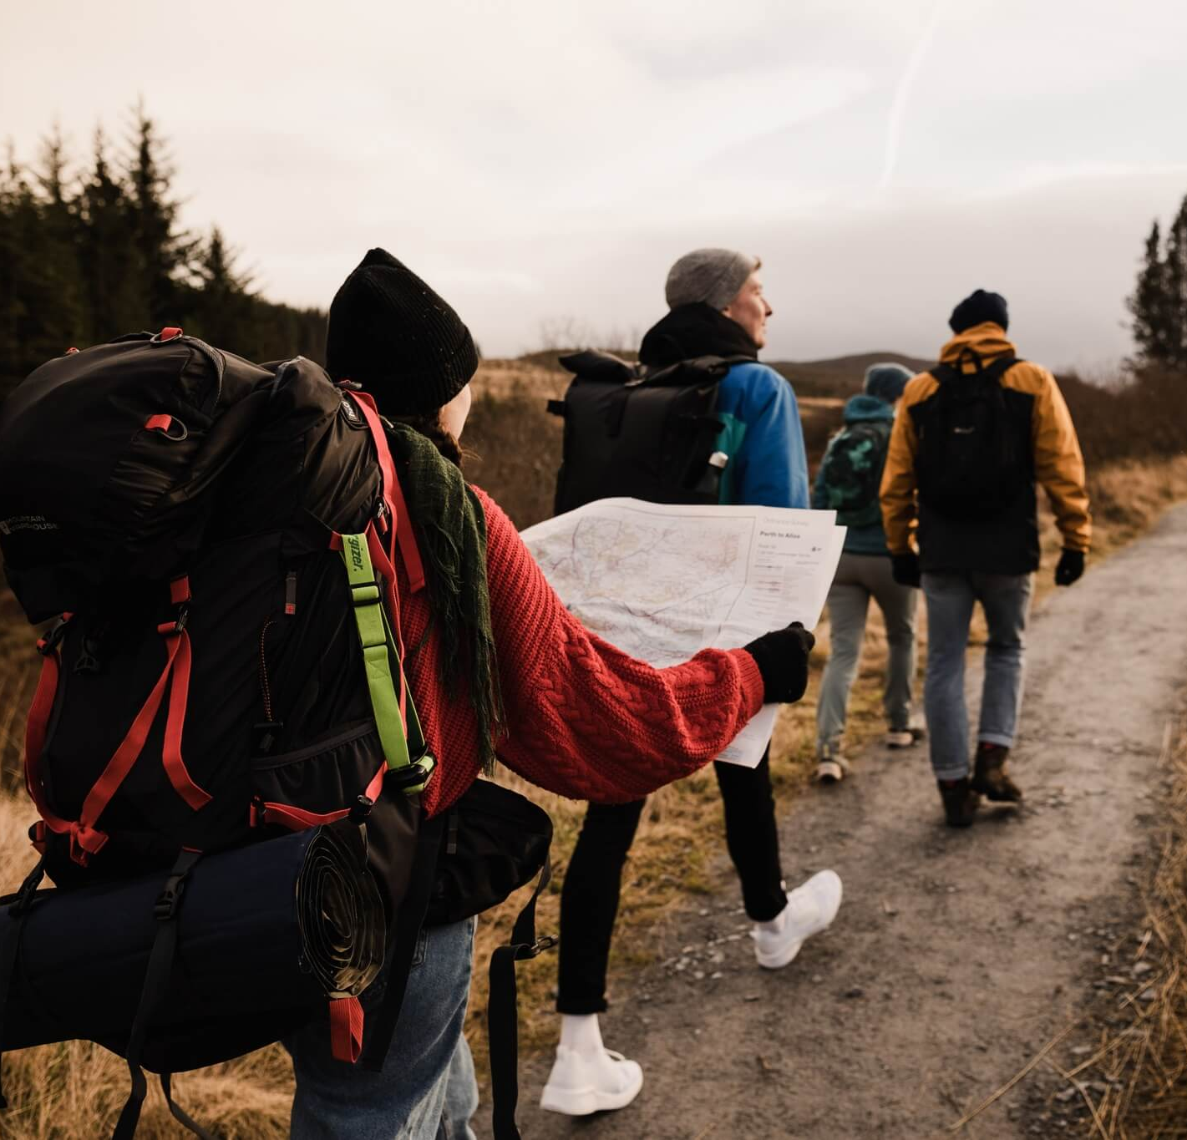
Case Study Summary
This case study features Blythe Timmerson and Jim Ford, who established Outland Adventures, an outdoor adventure business targeting hiking and camping enthusiasts. Initially a part-time venture, the success of their guided trips prompted them to quit their full-time jobs and focus entirely on Outland Adventures. Blythe Timmerson and Jim Ford hired guides to organize the trips. They also hired staff for marketing, equipment management, and website development. As the business expands, Blythe and Jim are now considering optimizing their operations. They have questions about the demand for equipment sales, the booking trends in different locations.​

Slide 4
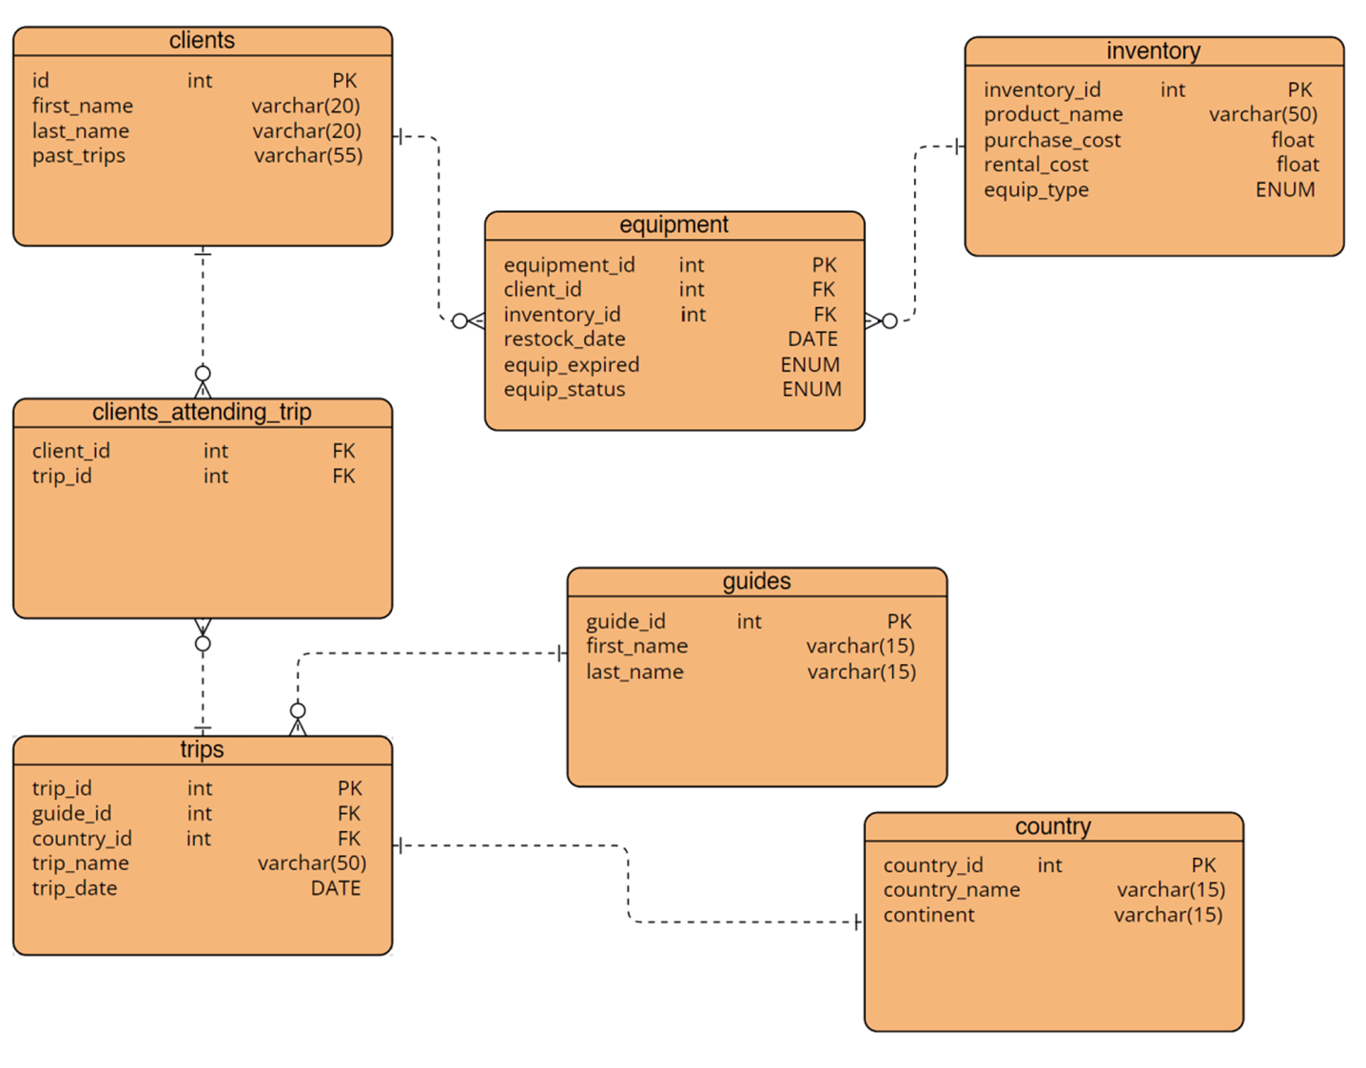
ERD
Initially, there were group discussions on how to implement the ERD. While thinking about real-world applications and how they would dynamically change, we had a complex design that kept growing due to the different scenarios that would come up due to the nature of the business. After further thought, we agreed on a more efficient, straightforward approach focusing more on the clients and the trips themselves. By doing so, we came up with this simpler version

Slide 5
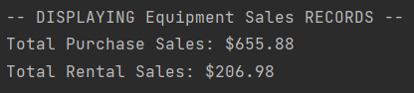
Equipment Sales Records
This record provides an intriguing snapshot of equipment sales, revealing purchase and rental sales figures. The total purchase sales amount to an impressive $655.88, showcasing the popularity and demand for equipment purchases. Meanwhile, the rental sales show a notable $206.98, indicating a secondary revenue stream and the value customers place on temporary equipment use.

Slide 6
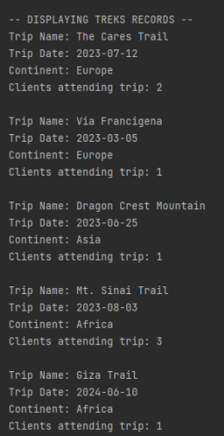
Trek Records
This collection of records represents a diverse range of expeditions and locations with numerous dates that clients can attend for their trips. These trips offer unique adventures in Europe, Asia, and Africa. We have had two clients traverse the Cares trail on 7/12/23 and a solitary journey along the Via Francigena on 3/5/23 with one client. One client ventured into the majestic Dragon Crest Mountain in Asia on 6/25/23. Three clients explored the historic Mt. Sinai Trail on 8/3/23, and the upcoming Giza Trail expedition in Africa on 6/10/24 will enthrall a single participant. The results provide an outlook of how European and African trips tend to be more popular than in Asia. Three clients have traveled in Europe, and four clients will travel in Africa thus far, making a grand total of 7 trips between the two!

Slide 7
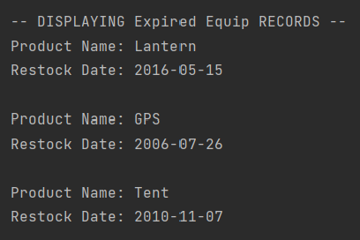
Expired Equpment Records
Our expired equipment collection shows a variety of products that have reached the end of their useful life. The equipment that is available to rent or purchase is regularly inspected. Equipment inspections ensure they are in excellent condition. The first item, a Lantern, was restocked on May 15, 2016, and has expired. The second item, a GPS, restock date is listed as July 26, 2006, and has lapsed. Lastly, we have a Tent, which was restocked on November 7, 2010, and has now reached its expiration date. These records help prompt us to renew and replenish the inventory to meet future needs.

Slide 8

Assumptions
All equipment is used according to ‘first in, first out’.
Since there are two guides, there can only be two trips at a time.
Old equipment must be replaced by new equipment.
Clients can choose to rent or purchase equipment.
Past trips are saved for users to track potential sales.

